Slide 1
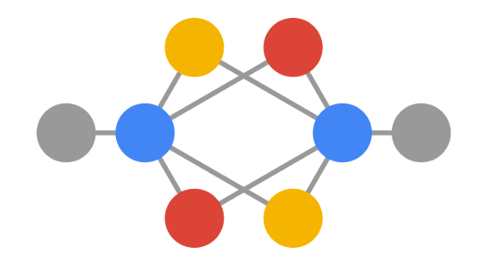

Group 23 Members:
-Santiago Federico Caballero Pastor
-Andrés Eduardo Cardozo Blanco
-Raquel Hernández Recio
-Toni Steger
-Alvin Lin Tsai

Slide 2
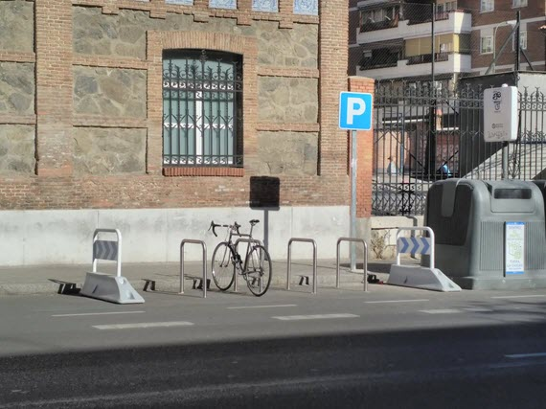
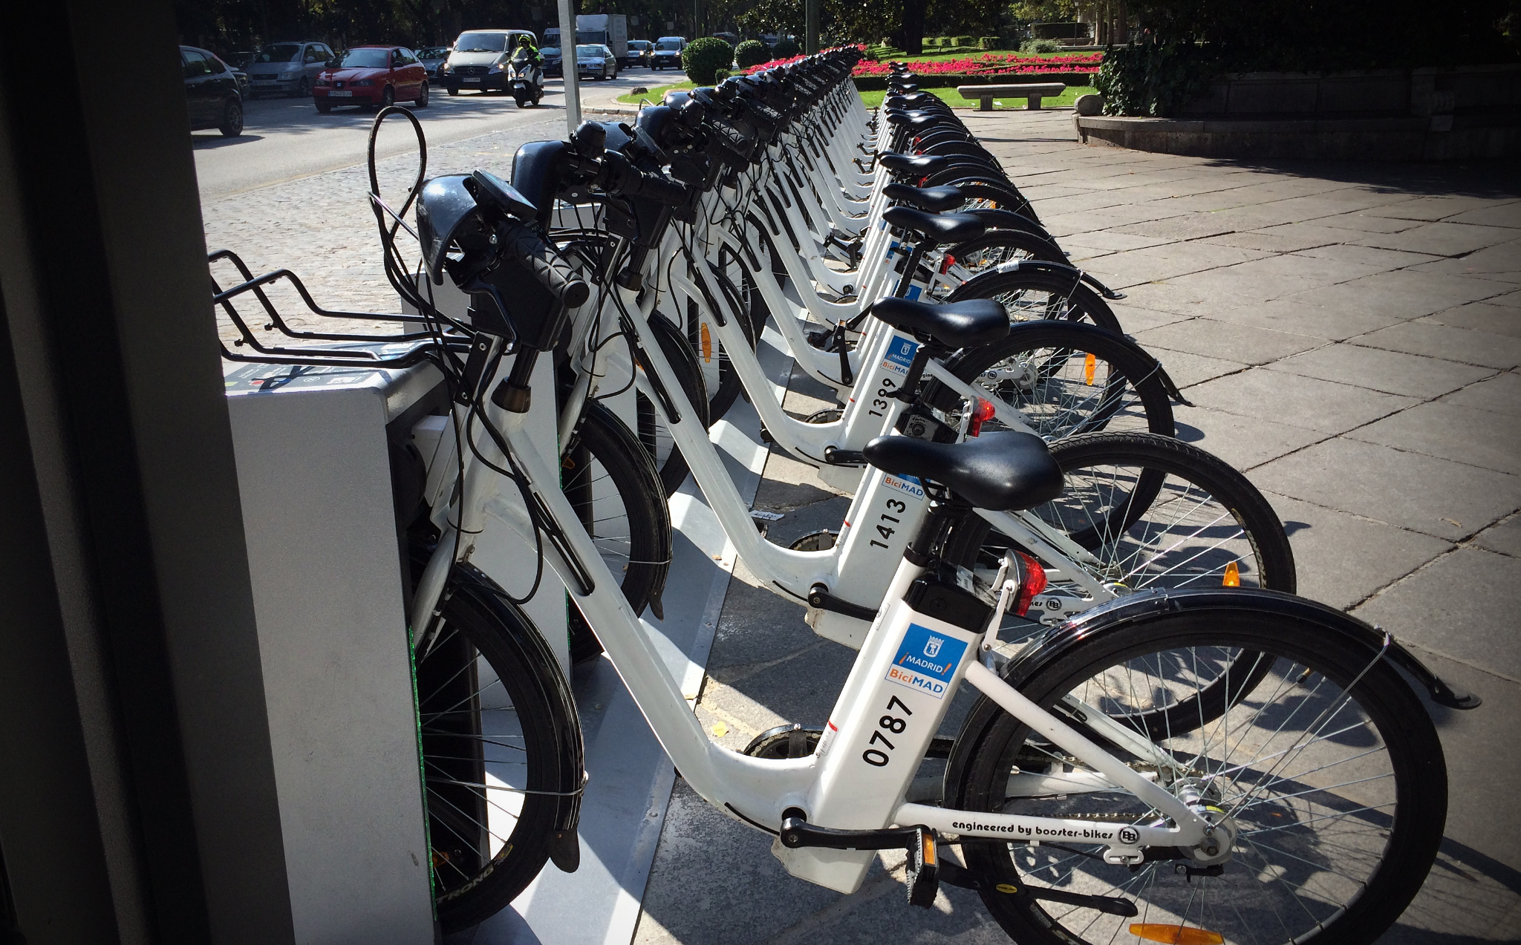
CSV

Slide 3
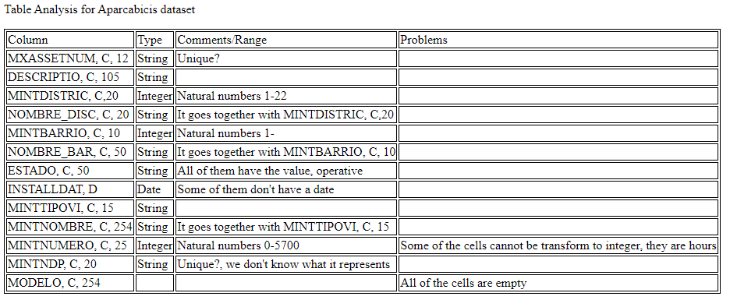
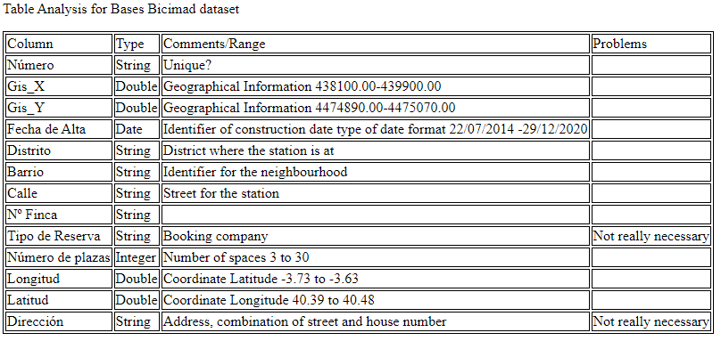
Analysis & Requirements

Slide 4
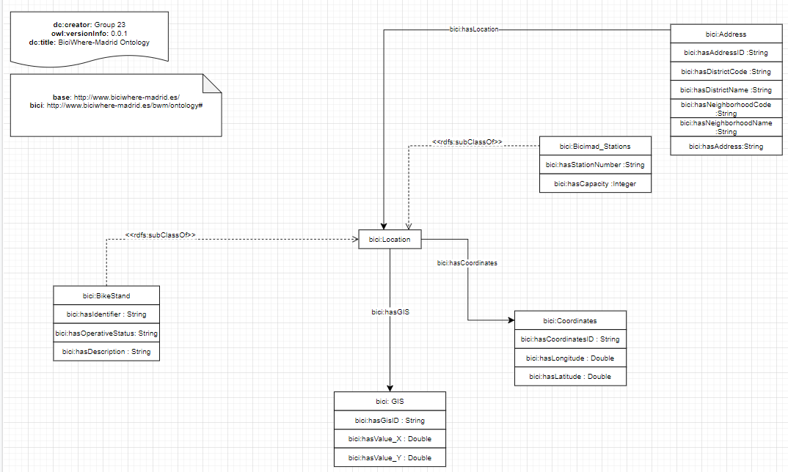
Ontology

Slide 5
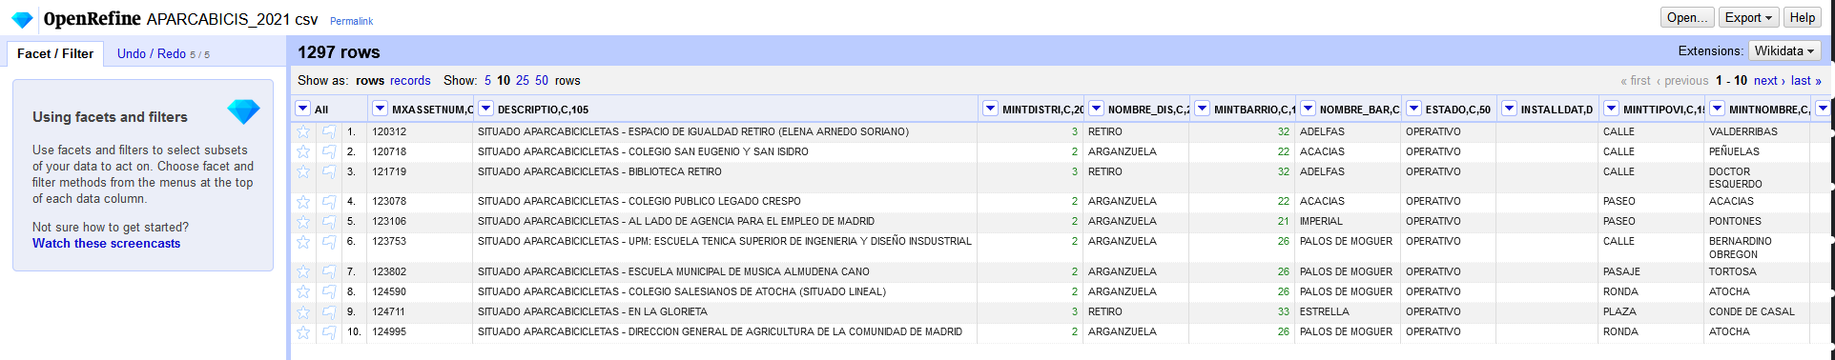
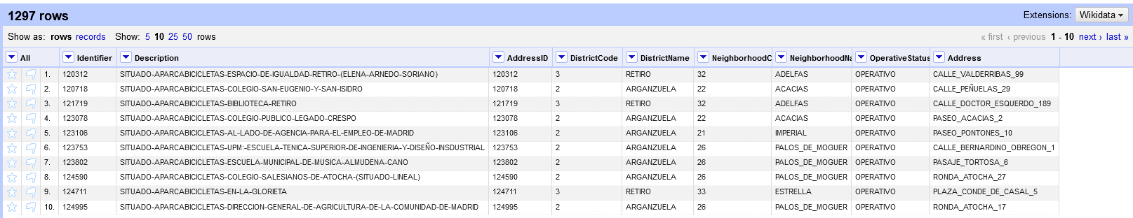
Cleaning data for the .csv

Slide 6
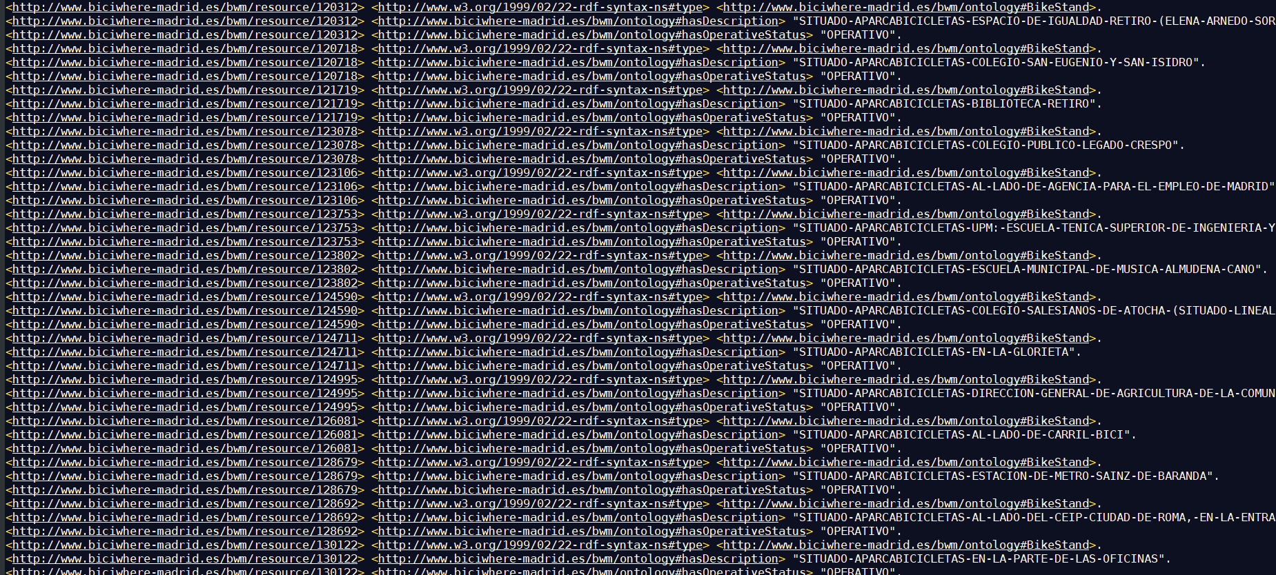
RDF Generation with the yml & rml

Slide 7
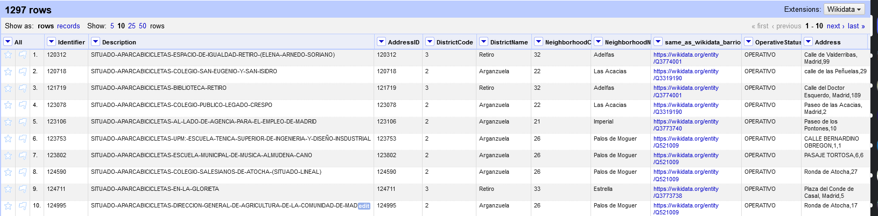
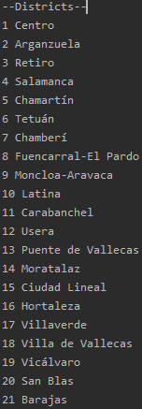
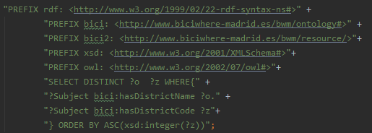
Entity Links & SPARQL queries

Slide 8
Application
Demonstration

Slide 9


Thank you for attending our presentation

